Slide 1
ACA Moving Forward in 2016

Slide 2
AGENDA
First Advantage ACA Program Demonstration - Doug
Selerix – Alyssa
Worxtime – Marcia
Maintaining Data for 2016 Reporting
Adding New Employee
Terminating Employees
Adding New Jobs
Inactivating Jobs
Payroll Procedures – UPDCAL Pay Types used properly

Slide 3
Adding New Employee
Enter Hire Date in BIOSCN (first date on the job)
BIOSCN: Please remember NO PUNCTUATION in Name or Address

Slide 4
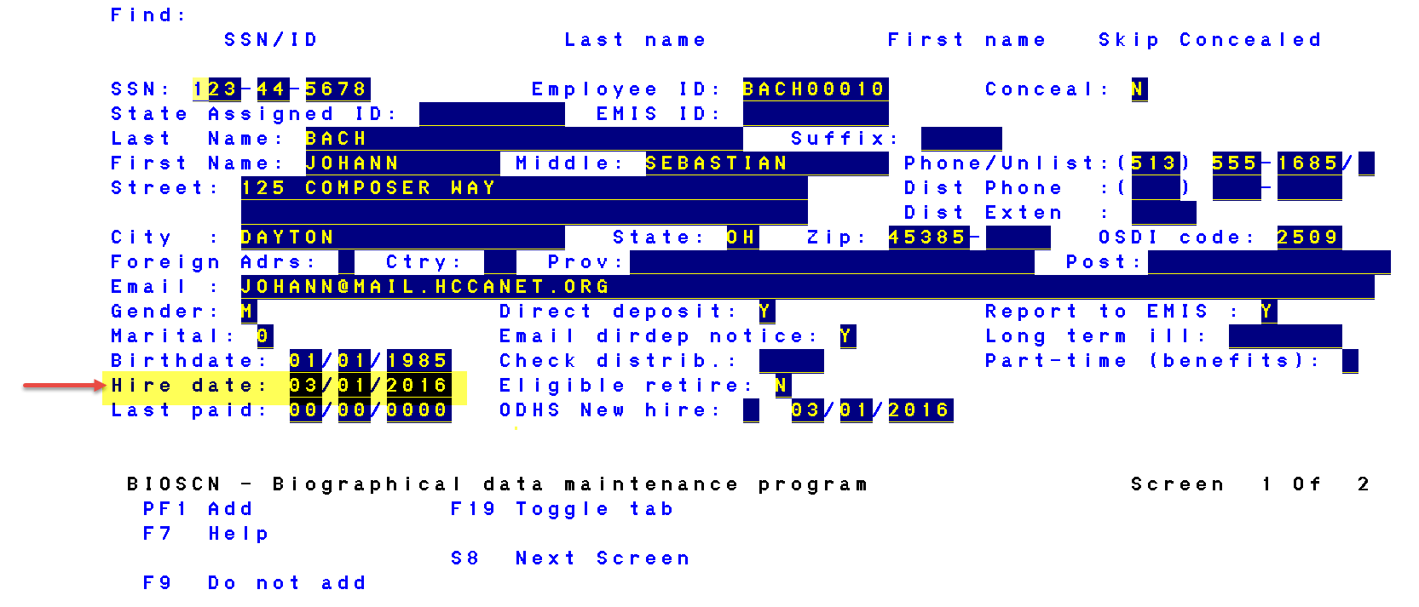
Adding New Employee

Slide 5
Adding New Employee
FT/PT Status
Worxtime & Selerix: FTE or VHE pulls from JOBSCN
EMIS FIELD FTE or
SALARY SCHEDULE FIELD FTE
If FTE is entered in both EMIS field and Salary Schedule Field, EMIS FTE will report to Worxtime
If no FTE in either location, VHE will be reported to Worxtime

Slide 6
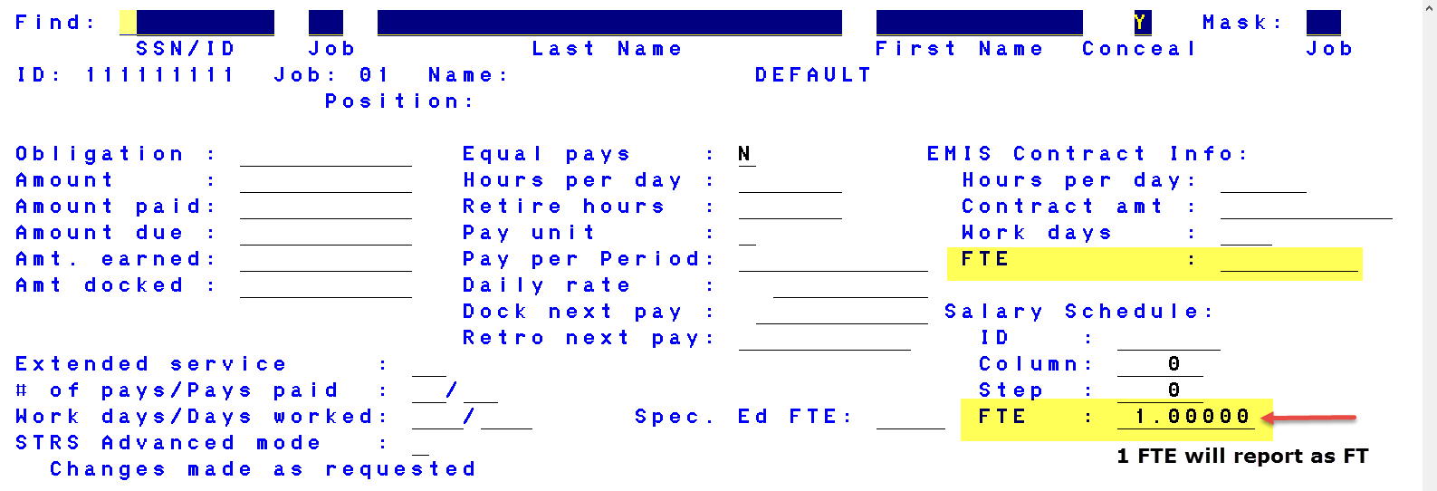
Adding New Employee Worxtime and Selerix

Slide 7
Adding New Employee FT/PT Status First Advantage
FIRST ADVANTAGE:
FT/PT Status
USPSWEB
QUERY EMPLOYEE
MODIFY EMPLOYEE DETAILS
ENTER FT or PT STATUS IN USER DEFINED FIELD 4

Slide 8
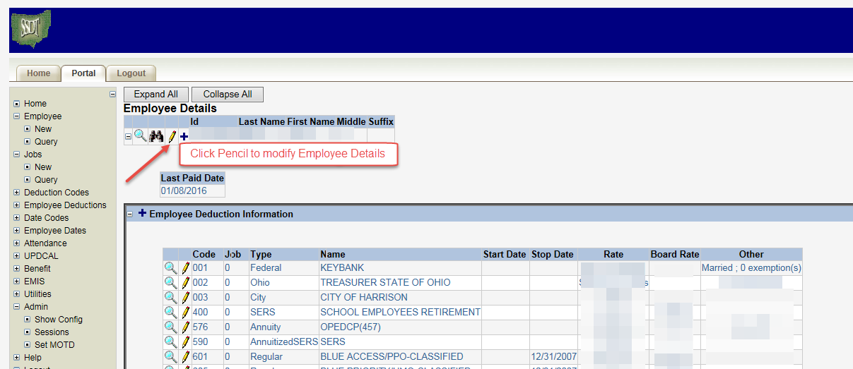
Adding New Employee FT/PT Status First Advantage

Slide 9
Adding New Employee FT/PT STATUS First Advantage

Slide 10
Adding New Employee
Position Start Date/JOBSCN
JOB STATUS CODE/JOBSCN
BUILDING IRN/JOBSCN
BUILDING DEPT/JOBSCN
HOURS PER DAY/JOBSCN
PAY UNIT/JOBSCN/PAGE 2 (Daily or Hourly Rate)

Slide 11
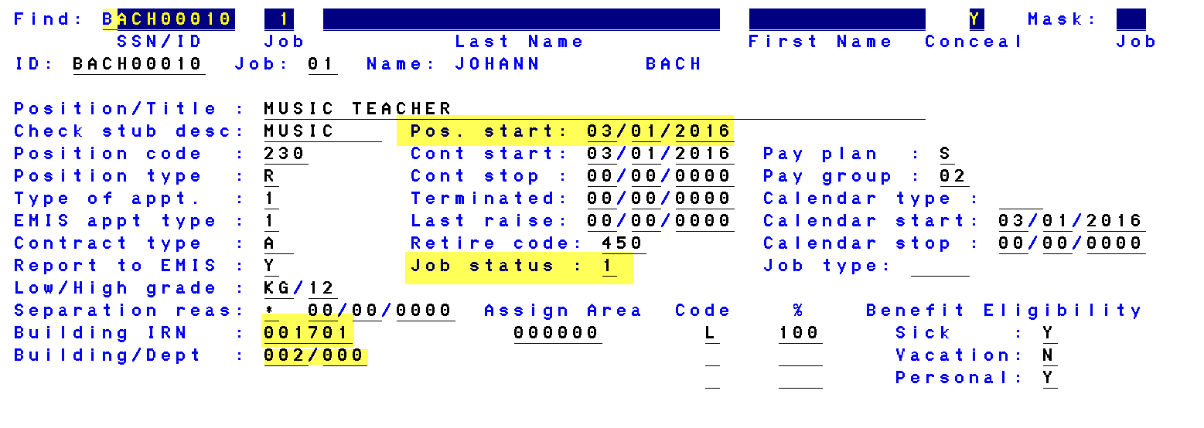
Adding New Employee

Slide 12
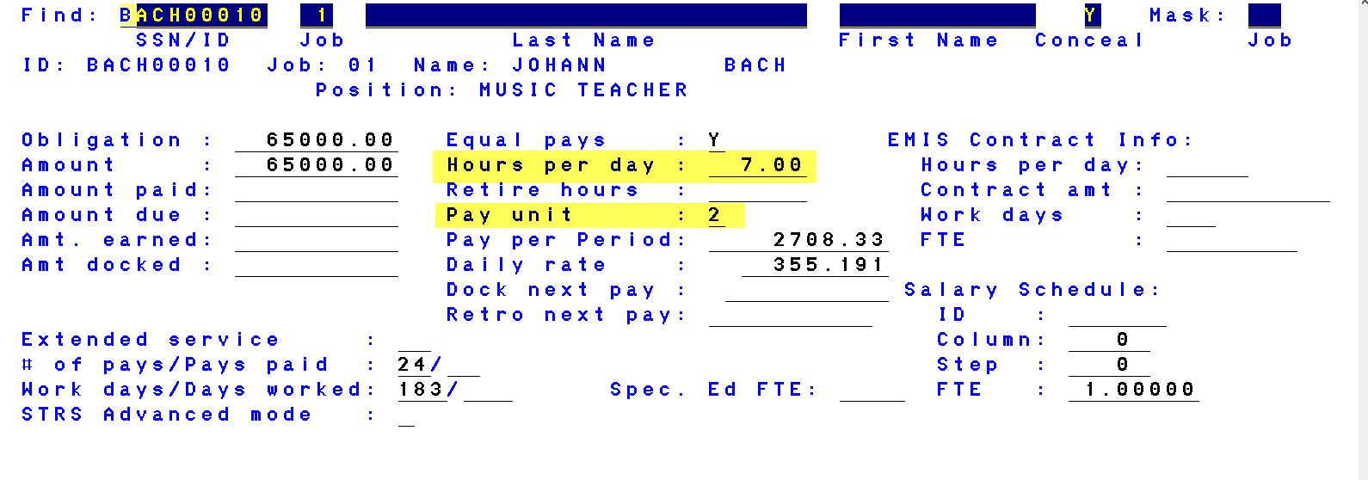
Adding New Employee

Slide 13
Adding New Employee
START DATE/DEDSCN/BENEFITS
STATUS/POSSCN/(We must follow guidelines, per EMIS regulations, despite request of ACA vendors) If employee is NOT EMIS reportable this field can be updated at any time

Slide 14
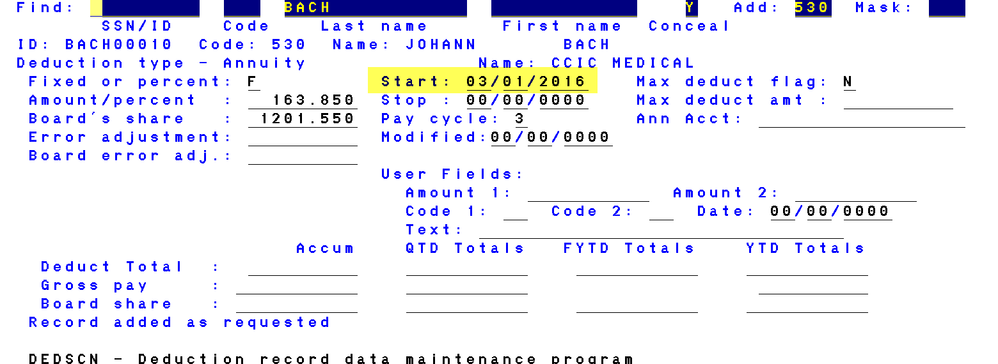
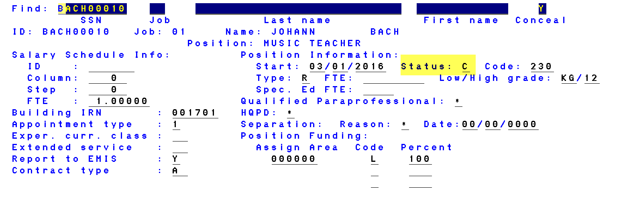
Adding New Employee
START DATE/DEDSCN
POSSCN/STATUS

Slide 15
TERMINATING EMPLOYEES
Termination Date/BIOSCN/2nd page
Termination date must be equal to or later than the last paid date in BIOSCN
Termination Date/JOBSCN
Job Status Code/JOBSCN
Stop Date/DEDSCN/Benefits
Separation Reason/JOBSCN/(even if not EMIS reportable)
Status Code/POSSCN/(we must follow guidelines per EMIS regulations despite request of ACA vendors) If employee is NOT EMIS reportable this field can be updated at any time.

Slide 16
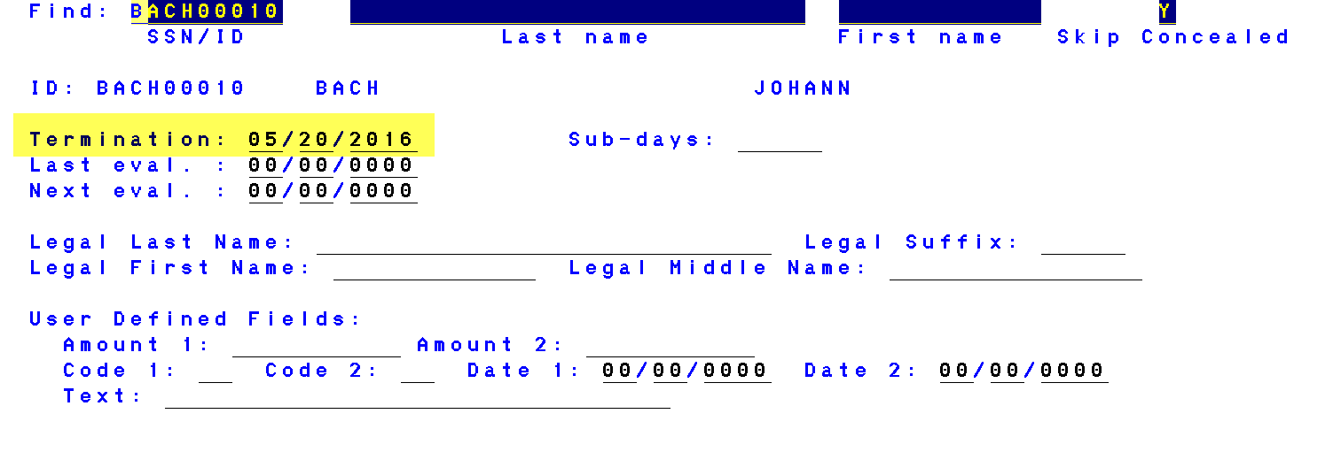
TERMINATING EMPLOYEES
Termination Date BIOSCN – (must be equal to or greater than last paid date in BIOSCN

Slide 17
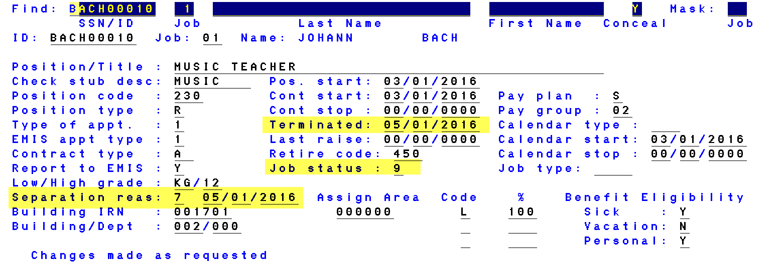
TERMINATING EMPLOYEES
Termination Date/JOBSCN
Status Code/JOBSCN
Separation Reason and Date (Even if not EMIS reportable employee)

Slide 18
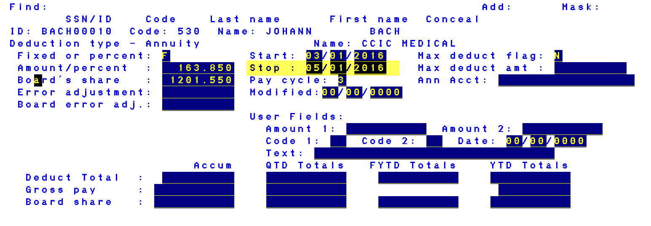
TERMINATING EMPLOYEES
DEDSCN/Benefits Termination Date

Slide 19
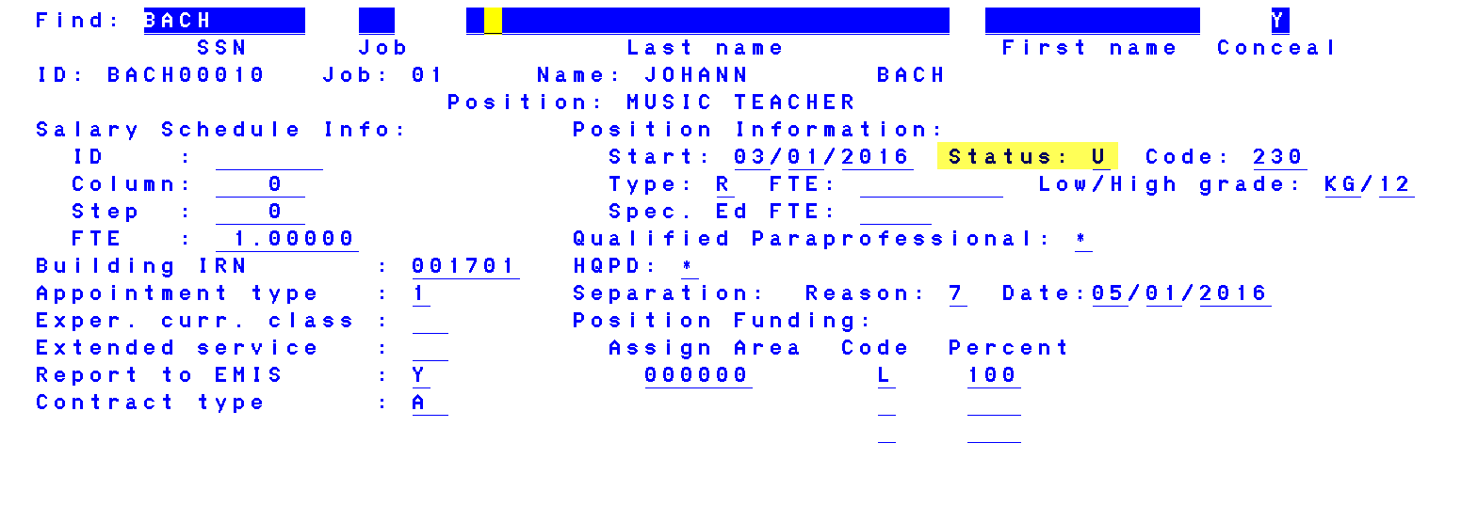
TERMINATING EMPLOYEES
POSSCN/STATUS CODE: (we must follow guidelines per EMIS regulations despite request of ACA vendors) If employee is NOT EMIS reportable this field can be updated at any time.

Slide 20
Adding New Jobs
Position Start Date/JOBSCN (first date on the new job)
Job Status Code/JOBSCN
Building IRN/JOBSCN
Building Dept/JOBSCN
Hours Per Day/JOBSCN
Pay Unit/JOBSCN/Page 2 (Daily or Hourly rate)
FTE/JOBSCN/Salary Schedule Field or EMIS Field (Worxtime & Selerix)
Status/POSSCN/(we must follow guidelines per EMIS regulations despite request of ACA vendors) If employee is NOT EMIS reportable this field can be updated at any time.
If FT/PT Status changes due to this position change, or adding a new job, remember to update FT/PT Status in USPSWEB (First Advantage only)

Slide 21
Adding New Jobs

Slide 22
Adding New Jobs

Slide 23
Adding New Job Worxtime and Selerix

Slide 24
Adding New Job First Advantage
FT/PT Status only needs to be updated if the new Job changes the employee’s status.

Slide 25
Adding New Job
STATUS/POSSCN/(We must follow guidelines, per EMIS regulations, despite request of ACA vendors) If employee is NOT EMIS reportable this field can be updated at any time

Slide 26
Inactivating Jobs
Termination Date/JOBSCN
Status Code/JOBSCN
Separation Reason & Date/JOBSCN (even if not EMIS reportable)
Status Code/ POSSCN (We must follow guidelines, per EMIS regulations, despite request of ACA vendors) If employee is NOT EMIS reportable this field can be updated at any time

Slide 27
Payroll Procedures
Please use UPDCAL Pay Types Properly:
REG, MIS, OT, DCK, BCK
(ACA vendors are monitoring wages based on the above, especially OT)
Retire Hours: ACA vendors retrieve Retire Hours from:
JOBSCN/HOURS PER DAY
UPDCAL/RETIRE HOURS FIELD
ATDSCN/AD RH (If adjusting hours, enter pay date as adjustment date)

Slide 28
First Advantage Leave of Absence
First Advantage assigned a code to report Leave of Absence from the district.
L3 – Leave of Absence
Enter L3 in USPSWEB > Employee Query >

Slide 29
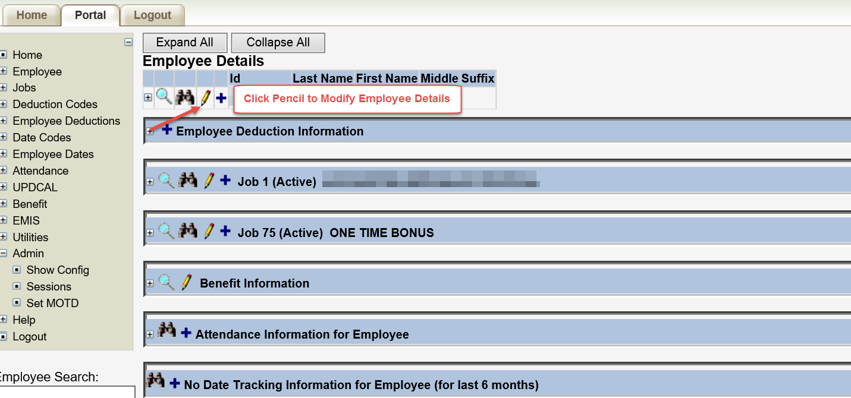
First Advantage Leave of Absence

Slide 30
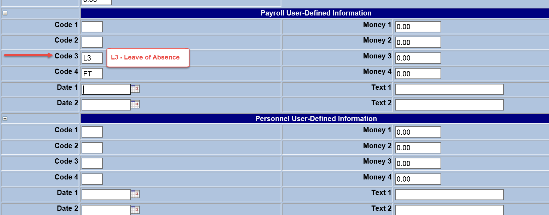
First Advantage Leave of Absence
Enter L3 – Leave of Absence to report employees on extended Leave of Absence from the district.
Remember to remove L3 when the employee returns

Slide 31
First Advantage 2016
HCC and First Advantage will be working to determine how hours are being pulled. First Advantage communicated hours for full time employees (teachers for example) are calculating with .01 hours causing full-time employees to report as part-time.
Duplication of SSN’s > Multiple employees reporting with the same SSN.
Once the source has been determined and the errors corrected we will contact First Advantage districts and release Doug’s program to report 2016 data.

Slide 32
Worxtime 2016
Each payroll, Worxtime districts will need to submit a SET of data files to Worxtime (even special pays)
EE_UPLOAD2.CSV FILES (OPTION 1 - Worxtime program)
Enter a single pay date as beginning and ending PAID DATE
HRS_UPLOAD2.CSV FILES (OPTION 2 - Worxtime program)
Enter a single pay date as beginning and ending PAID DATE
Name the file per Worxtime guidelines
Ex: hrs_upload_HCESC_20160115.csv

Slide 33
Message from Worxtime
1 EE file and 1 HRS file for each pay period encapsulating all hours worked and demographic changes that may have taken place within that pay period.
Usually, clients have one master EE file that they simply keep updated and resubmit with each new HRS file after a pay period. The master EE can be exported from Worxtime at any time (Reports > Reports > Employee Demographic Report > Export)
The EE updates are to capture any EmpType changes (VHE to FTE or vice versa), new hires, new termination date, rehires that occur with in that Pay Period.
It is best to fall into a rhythm of submitting files after each pay period. This allows for all the data to be up to date and the clients to be notified when any employee becomes benefit eligible based on hours worked and needs to be offered coverage.

Slide 34
Discussion

Slide 35
Happy Easter

